Slide 1
Moore and Mealy Machines

Slide 2

Moore Machine

Slide 3
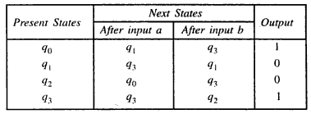
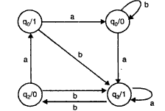
Example

Slide 4

Continued….

Slide 5

Mealy Machine

Slide 6
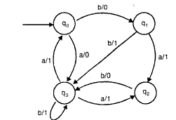
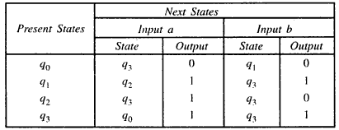
Example

Slide 7

Continued….

Slide 8
Example 1

Slide 9
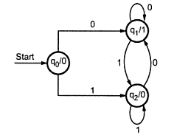
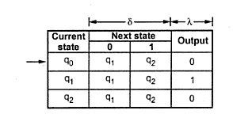

Solution

Slide 10

Example-2

Slide 11
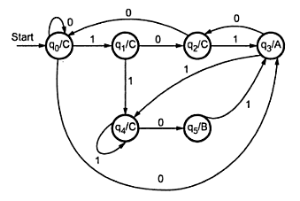
Solution-Moore Machine

Slide 12
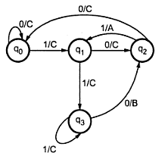
Solution- Mealy Machine

Slide 13
Example

Slide 14
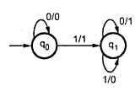
Solution

